Slide 1

Lecture 7: Client/Server
Web Applications
Client Side –v- Server Side
Patrick Donohue
Limerick Institute of Technology
© Gerry Guinane

Slide 2
Learning Outcomes
You will be able
Describe both client and server side web applications
Recognize a simple client side script using Javascript
Recognize a simple server side script using PHP

Slide 3
How to : Author a Simple/static web page
Open notepad
Enter this text, save the file to the Apache root folder as testindex.html
<html>
<head><title>Test Web Page</title></head>
<body>
<h1>My Web page</h1>
<p>Hello - Welcome to the SD2 Web page</p>
</body>
</html>

Slide 4
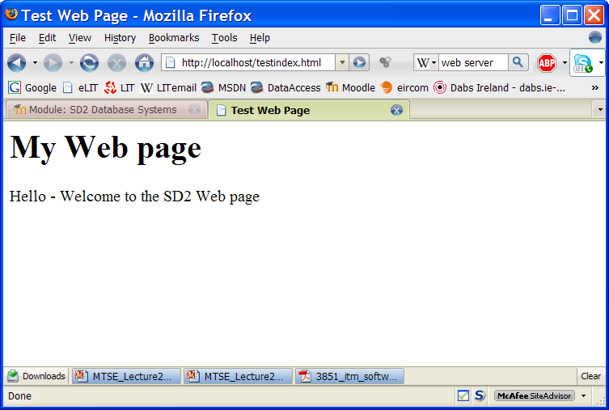
View the web page

Slide 5
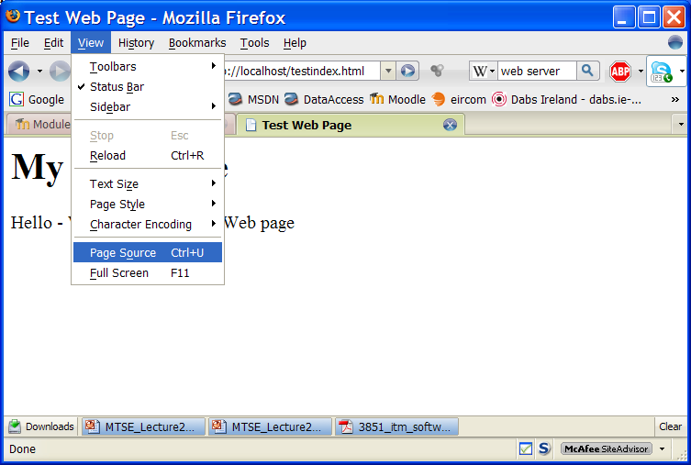
View the html source
This is a useful way to see the actual file that the SERVER has sent to the BROWSER

Slide 6
DBS and Web Applications
Many web servers are capable of hosting an APPLICATION server also.
Generally a DATABASE is used to store data used in the Web Application
This technology has led to the availability of DYNAMIC content web pages

Slide 7
Dynamic content.
There are two ways of getting dynamic content into a web page.
They are defined in terms of where the ‘processing’ is done
Client side scripting – the processing of code is done by the client
For example JAVASCRIPT
Server side scripting – the code is processed by the web server and then sent to the client
For example PHP, ASP

Slide 8

Client side processing
Processing is done on the client side
Client
Browser
Application
Internet
Web Server
DNS
Domain Name Server

Slide 9
Client side scripting - Javascript
The script is embedded in the html file
The html file is sent to the browser in the usual way by the server
The browser (client) executes the Javascript (also known as Jscript)

Slide 10
Javascript – client side - hello world example
Note : Cut n paste from Powerpoint to the notepad sometimes doesn’t work. Normally this is fixed if you delete all “double quotes” in your notepad editor and type them in again!!!
Open notepad, insert this text and save as testjava.html
In the browser – open the page
http://localhost/testjava.html
<html>
<head><title>Javascript example</title></head>
<body>
<script type="text/javascript">
document.write("Welcome to SD2 Database Systems");
</script>
<noscript>
Your browser either does not support JavaScript, or you have JavaScript
turned off.
</noscript>
</body></html>
Note – if Javascripting is not enabled in your browser the <noscript> text is displayed.
Notes:
<html>
<head><title>Javascript example</title></head>
<body>
<script type="text/javascript">
document.write("Welcome to SD2 Database Systems");
</script>
<noscript>
Your browser either does not support JavaScript, or you have JavaScript
turned off.
</noscript>
</body></html>

Slide 11
Javascript – Functions can be defined
<html>
<head>
<title>Javascript example</title>
<script type="text/javascript">
function displaymessage()
{
alert("Hello World!");
}
</script>
</head>
<body>
<form>
<input type="button" value="Click me!" onclick="displaymessage()" >
</form>
</body>
</html>
Functions are normally defined in the <head> section
Tutorial on Javascript: http://www.w3schools.com/js/default.asp
Notes:
<html>
<head>
<title>Javascript example</title>
<script type="text/javascript">
function displaymessage()
{
alert("Hello World!");
}
</script>
</head>
<body>
<form>
<input type="button" value="Click me!" onclick="displaymessage()" >
</form>
</body>
</html>

Slide 12
JS – interaction with the host machine (your PC)
<html>
<head>
<script type="text/javascript">
function startTime()
{
var today=new Date();
var h=today.getHours();
var m=today.getMinutes();
var s=today.getSeconds();
// add a zero in front of numbers<10
m=checkTime(m);
s=checkTime(s);
document.getElementById('txt').innerHTML=h+":"+m+":"+s;
t=setTimeout('startTime()',500);
}
function checkTime(i)
{
if (i<10)
{
i="0" + i;
}
return i;
}
</script>
</head>
<body onload="startTime()">
<h1>System Clock</h1>
The time is:
<div id="txt"></div>
</body>
</html>

Slide 13
Server Side Scripting
Client
Browser
Application
Internet
Web Server
Web Application Server
This is the typical architecture of a server side web application – the next few slides explain each element
DNS
Domain Name Server
DATABASE
Server (DBMS)

Slide 14
Server Side Scripting
The Web Server is normally IIS or Apache httpd server.
It contains normal web pages/files in html and web pages containing ‘scripts’
Html files usually have an extension .htm or .html
Scripts are executable code which is normally ‘embedded’ in the html. Script files will have extensions like .php or .asp or .cgi
Web Application Server
Web Server
Web Application Server
DATABASE
Server (DBMS)

Slide 15
Server Side Scripting
IF the client side browser requests a web page/file containing a SCRIPT from a Web Server – the Web Server passes the ‘script’ parts of the file to a Web Application Server for processing.
For example – if the client requests ‘index.php’ from the Web Server – the Web Server will pass on any PHP scripts to the Web Application Server for processing.
The Web Application Server returns HTML code to the Web Server to be inserted into the index.php file instead of the original script and sent to the client.
Web Application Servers are dedicated to processing specific scripting languages.
As a result the client browser only receives HTML
Web Application Server
Web Server
Web Application Server
PHP
HTML
DATABASE
Server (DBMS)

Slide 16
Simple Example!
PHP: Hypertext Preprocessor – is a commonly used scripting language
The next couple of slides show a simple hello world example of PHP and how it gets processed and delivered to a client
Note – our example doesn’t involve the database/DBMS – that’s another days work!

Slide 17
PHP Basics
PHP Scripts are embedded in HTML files using TAGS :
<?php
:
:PHP script here.
:
?>
The file extension is .php (example index.php)
When the Web Server receives a request from a browser client for a file with the extension .php it knows that it should be passed to the application server to be processed
The Application processor receives the PHP script, performs the required processing and returns a file containing HTML code ONLY to the Web Server
The processed file is sent to the browser by the web server
The browser displays the file which now contains HTML code only,

Slide 18
Example : sd2welcome.php
<html>
<head>
<title>SD2 DBS - Web Programming</title>
</head>
<body>
<?php
//This is a PHP comment
echo "<p>Welcome to SD2-DBS Web Programming";
echo "<p>";
$i=1;
while($i<=5) //This is a PHP while loop
{
echo "The value of the loop variable (i) is = " . $i . "<br />";
$i++;
}
?>
</body>
</html>

Slide 19
PHP is EMBEDDED in HTML
HTML
<html>
<head>
<title>SD2 DBS - Web Programming</title>
</head>
<body>
<?php
//This is a PHP comment
echo "<p>Welcome to SD2-DBS Web Programming";
echo "<p>";
$i=1;
while($i<=5) //This is a PHP while loop
{
echo "The value of the loop variable (i) is = " . $i . "<br />";
$i++;
}
?>
</body>
</html>
PHP BLOCK
HTML

Slide 20
Web App Example ..
The Web Server Receives the request from the client browser for sd2welcome.php
1
Apache
PHP Application Server
1
2
PHP
4
HTML
The Web Server forwards the requested file to the PHP application server for processing
2
htdocs/sd2welcome.php
3
3
The PHP application server returns the processed file to the Webserver – replacing all PHP code with HTML code
DATABASE
Server (DBMS)
4
The Web Server sends the processed file to the client browser

Slide 21
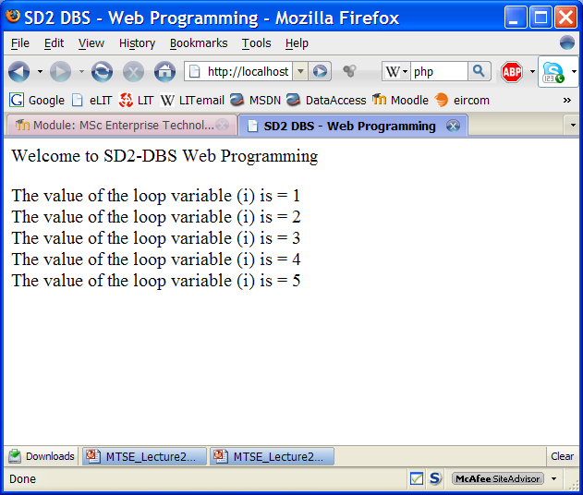
This is the page in the browser

Slide 22
Before Processing – sd2welcome.php
<html>
<head>
<title>SD2 DBS - Web Programming</title>
</head>
<body>
<?php
//This is a PHP comment
echo "<p>Welcome to SD2-DBS Web Programming";
echo "<p>";
$i=1;
while($i<=5) //This is a PHP while loop
{
echo "The value of the loop variable (i) is = " . $i . "<br />";
$i++;
}
?>
</body>
</html>

Slide 23
After Processing – sd2welcome.php as sent to the browser
<html>
<head>
<title>SD2 DBS - Web Programming</title>
</head>
<body>
<p>Welcome to SD2-DBS Web Programming
<p>
The value of the loop variable (i) is = 1<br />
The value of the loop variable (i) is = 2<br />
The value of the loop variable (i) is = 3<br />
The value of the loop variable (i) is = 4<br />
The value of the loop variable (i) is = 5<br />
</body>
</html>

